Slide 1
Learning
Chapter 6

Slide 2
Learning
A relatively permanent change in behavior that results from experience
Psychologists are interested in both the content of learning and the process
Types
Classical conditioning
Operant conditioning
Cognitive and social learning

Slide 3

Classical Conditioning: Examples
Notes:
Sound of a dentist’s drill: sweaty palms

Slide 4
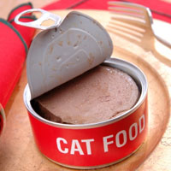
Notes:
Noise of a can opener: cat comes running

Slide 5
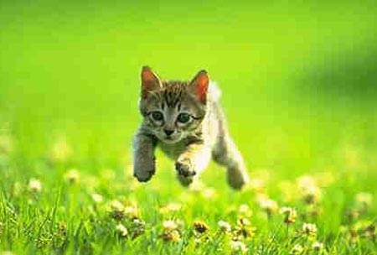

Slide 6
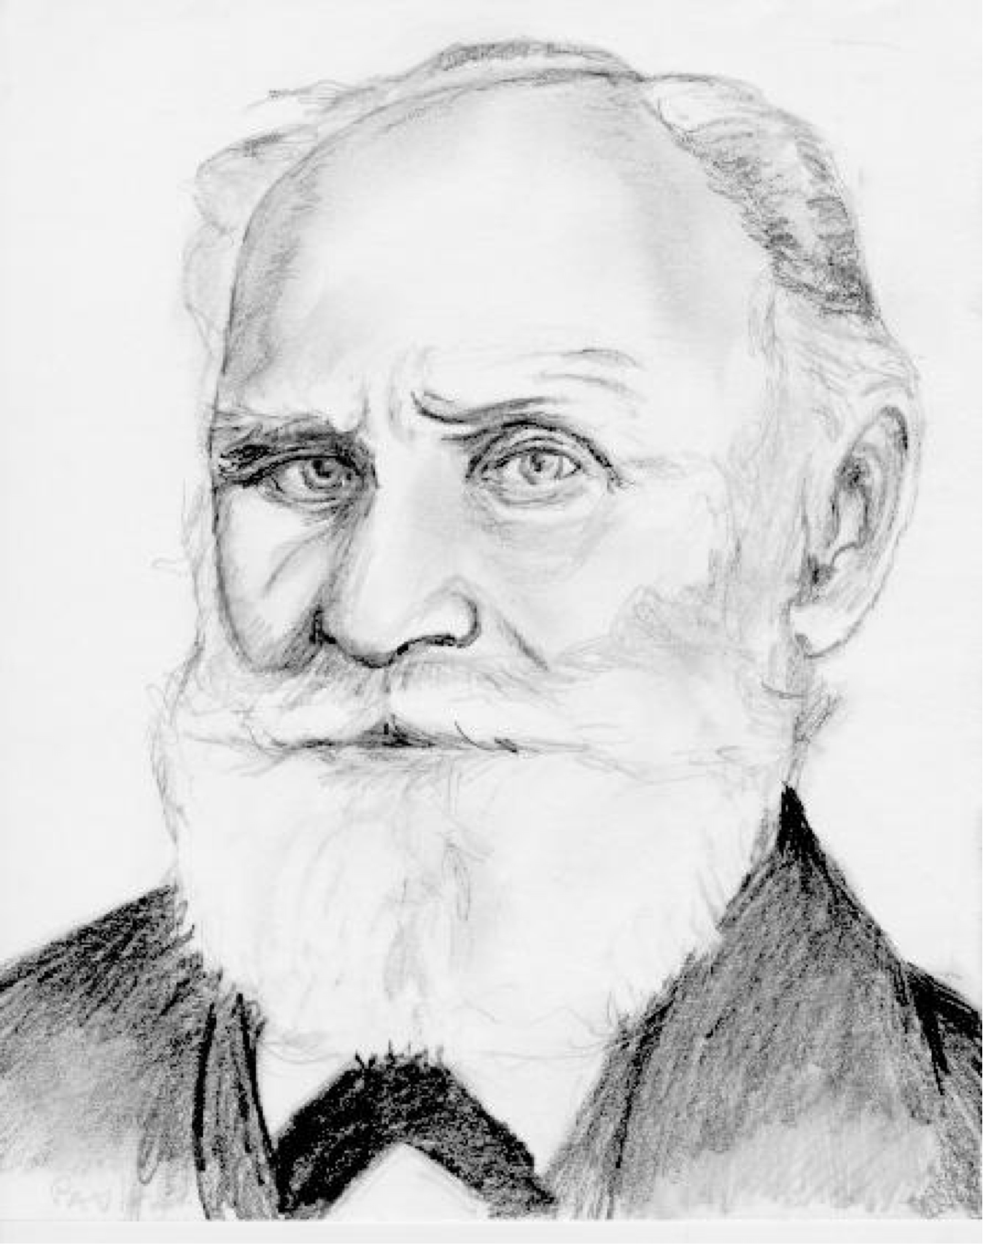
Classical Conditioning
Discovered (accidentally) by Ivan Pavlov
Components
Unconditioned Stimulus (US)
Unconditioned Response (UR)
Conditioned Stimulus (CS)
Conditioned Response (CR)

Slide 7
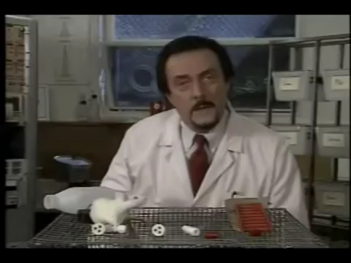

Slide 8
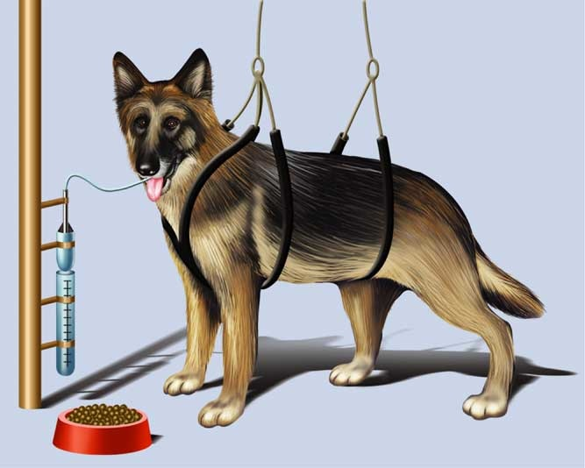
Pavlov’s Observation
Studied digestion in dogs
Presented meat powder and measured salivation
Dogs started salivating before food was presented
Why?

Slide 9
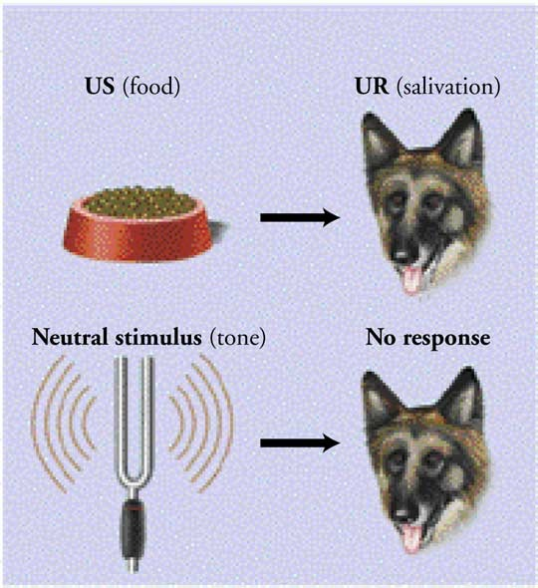
Pavlov’s Experiment: Phase 1
Food (US): salivation (UR)
Reflexive response
Tone: nothing

Slide 10
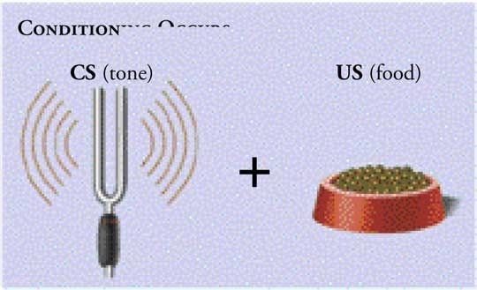
Pavlov’s Experiment: Phase 2
CS is repeatedly paired with the US
A tone is sounded before the food is presented
Acquisition
Notes:
Note: Figure 6.2 on page 215 in the textbook incorrectly labels the CS as “Food”

Slide 11
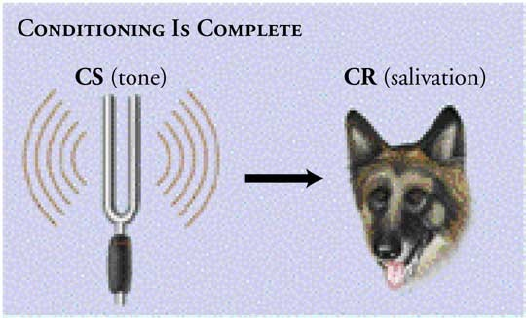
Pavlov’s Experiment: Phase 3
Eventually, the CS elicits a new CR
Classical conditioning is complete when hearing the tone by itself causes salivation

Slide 12
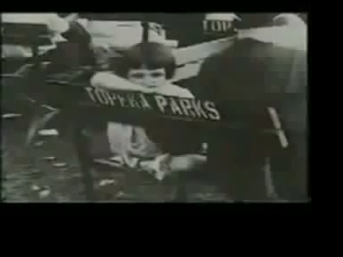

Slide 13
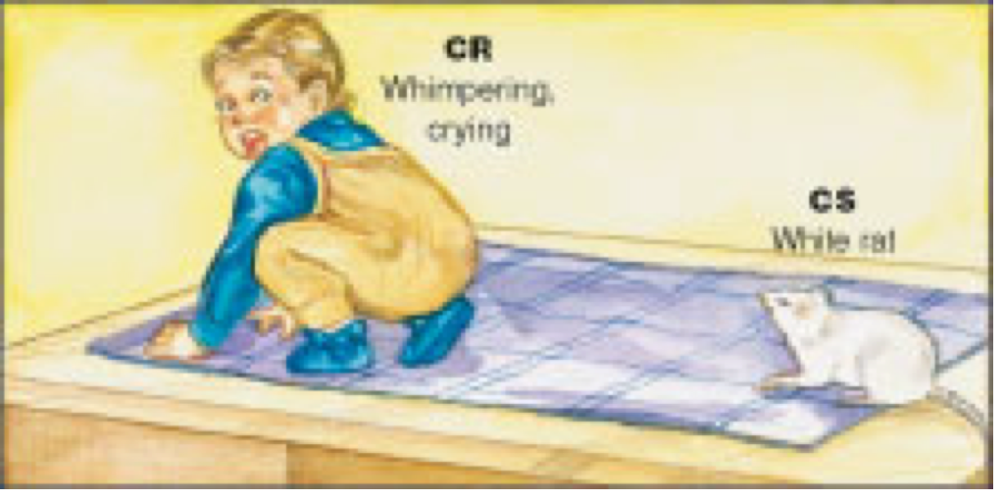
Classical Conditioning: Conditioned Emotional Response
Avoidance learning
Phobias
Little Albert
Biological preparedness
Contrapreparedness

Slide 14
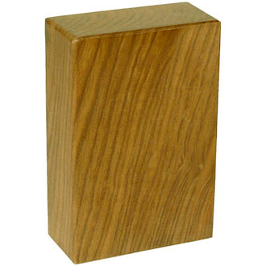

Slide 15
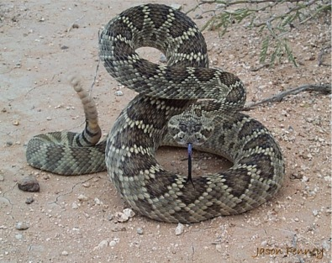

Slide 16
Classical Conditioning
Stimulus generalization
Stimulus discrimination

Slide 17
Dissecting Classical Conditioning
Learning to be afraid
Information registers in the brain
Amygdala reacts
Sets of neurons become linked

Slide 18
Classical Conditioning Applied
Drug overdoses
Conditioned compensatory response

Slide 19
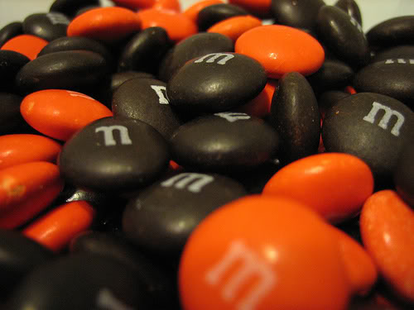
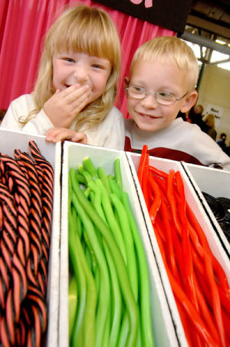
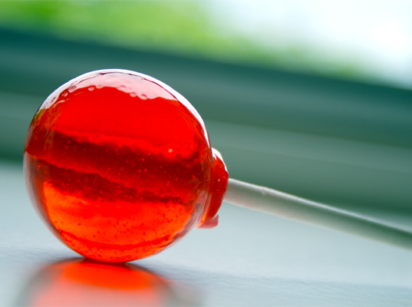

Slide 20


Slide 21
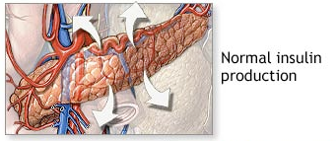

Slide 22
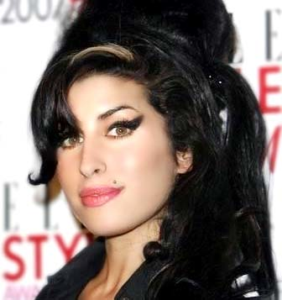

Slide 23


Slide 24
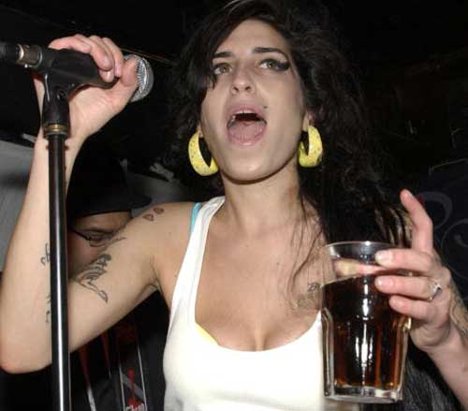

Slide 25
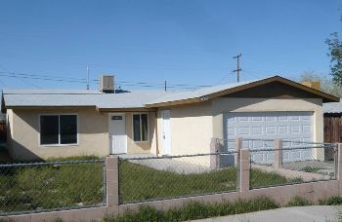

Slide 26
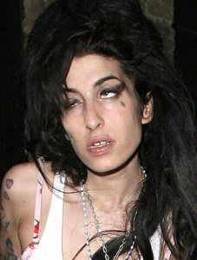

Slide 27
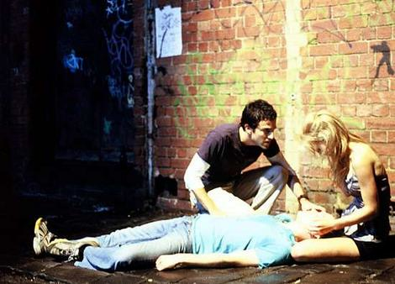

Slide 28
Turn to the person next to you and explain conditioned compensatory response
Notes:
Ashley Olson
Christiana Matyseck
Maria Mora
Robert Blas
Andruuuuu Furr
Gabriel Hernandez
Rubenette Giron
Rosalie Bermudez
Luis Cardenas
Emely Venegas
Kristen Anno

Slide 29
Types of Learning
Classical conditioning
Operant conditioning
Cognitive and social learning

Slide 30
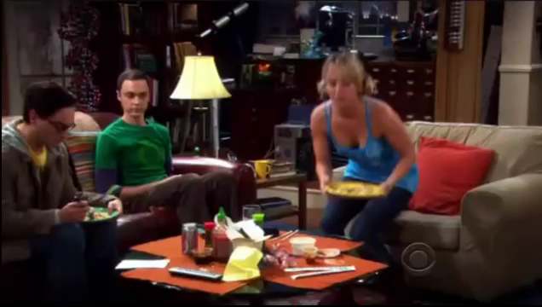

Slide 31
Operant Conditioning: Examples
Slot machine pays out: gamble more
Reward dog for sitting: dog is likely to sit
Tantrums are punished: fewer tantrums
Tantrums bring attention: more tantrums
How does this happen?
Notes:
Ashley Olson
Christiana Matyseck
Maria Mora
Robert Blas
Andruuuuu Furr
Gabriel Hernandez
Rubenette Giron
Rosalie Bermudez
Luis Cardenas
Emely Venegas

Slide 32
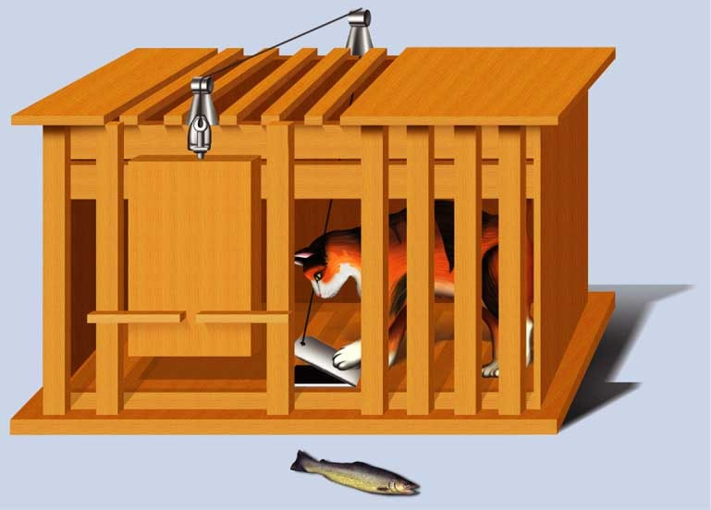
Operant Conditioning
The process whereby a behavior becomes associated with its consequences

Slide 33
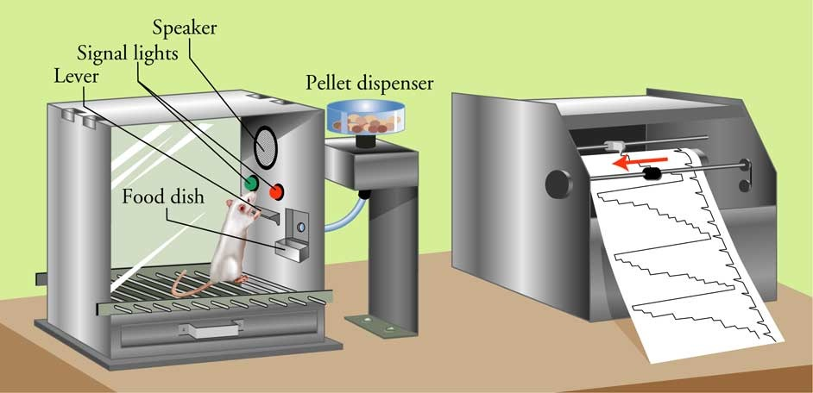
Operant Conditioning: Skinner Box

Slide 34
Operant Conditioning: Principles
Stimulus-response
Reinforcement
Positive reinforcement
Negative reinforcement
Punishment
Positive punishment
Negative punishment
Notes:
Kristen Anno
Amea Givens
Nathaniel Gonzales
Elisha Guillory
Diane Kamali-Meech
Michelle Mcclendon
Veronica Rodriguez
Brandon Tate
Brian Tate
Johnny Thomas
Rayleen R
Norma Alvarez

Slide 35

Positive Reinforcement

Slide 36

Negative reinforcement

Slide 37
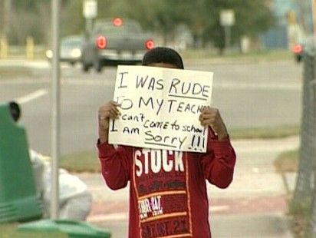
Positive Punishment

Slide 38
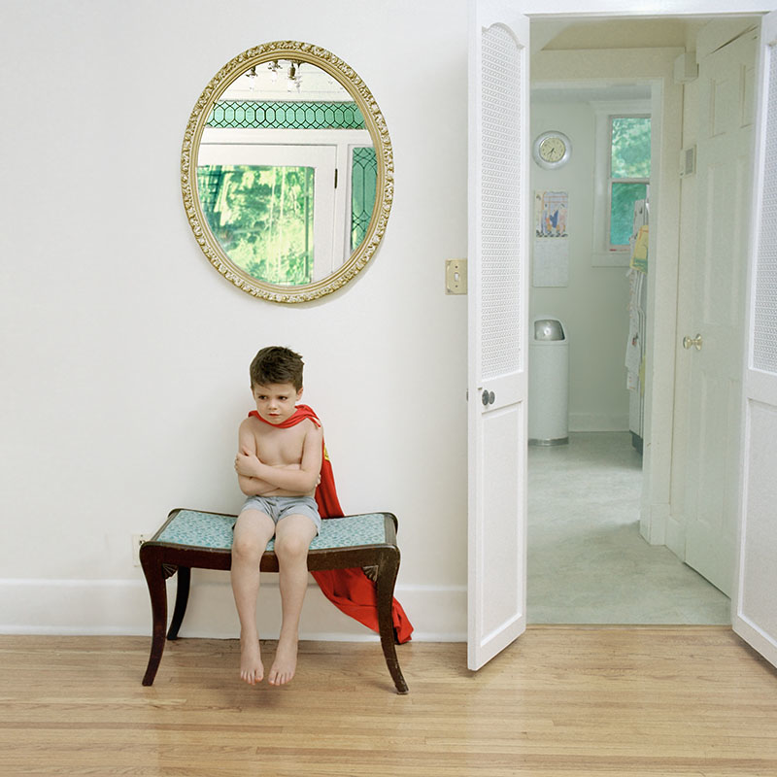
Negative punishment

Slide 39
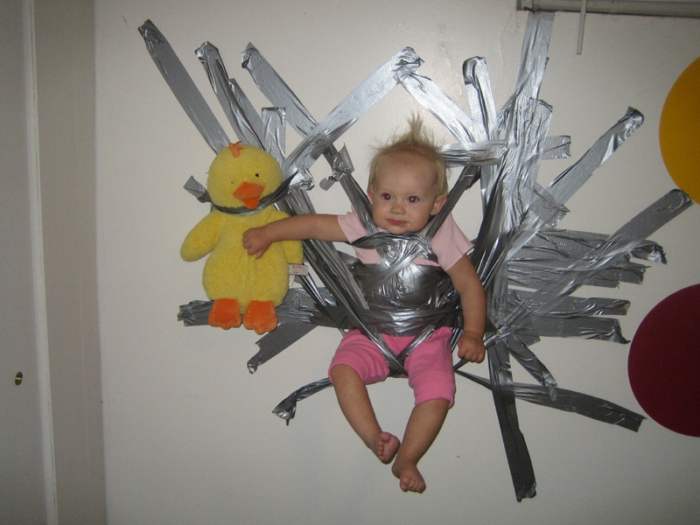

Slide 40


Slide 41
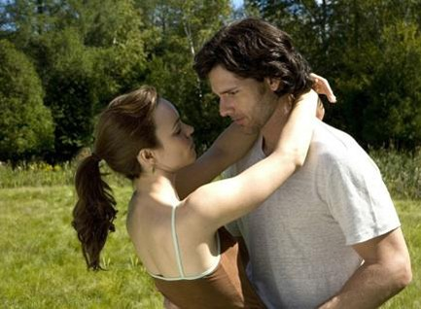
Wife wants same attention as when dating

Slide 42

Husband ignores wife
What is the ignoring?
Negative
or
Positive?
Punishment
or
Reinforcement?

Slide 43

She starts to nag him
What is the Negative Punishment
nagging? or or
Positive? Reinforcement?

Slide 44

Husband pulls away and wife feels more lonely
What is the pulling away?
Negative
or
Positive?
Punishment
or
Reinforcement?

Slide 45
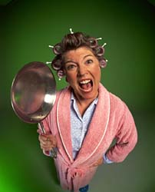
Wife really nags now…

Slide 46
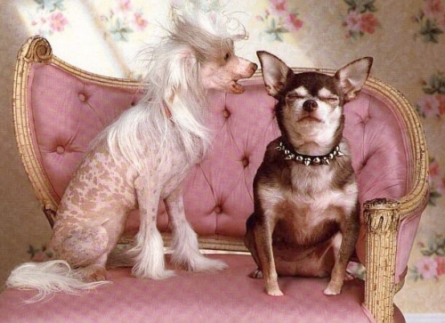
And nags…

Slide 47
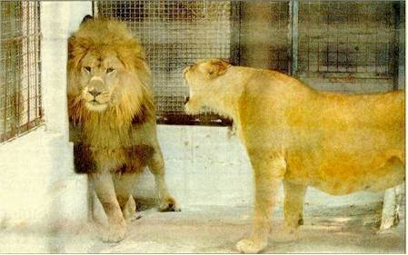
And nags…

Slide 48

And now he’s really ignoring

Slide 49


Slide 50


Slide 51
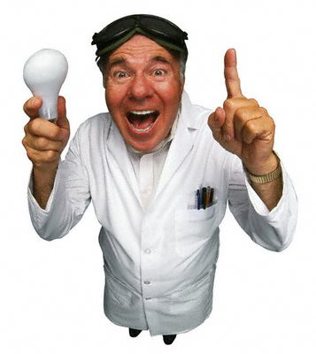

Slide 52
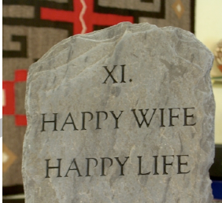

Slide 53
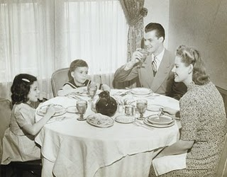

Slide 54
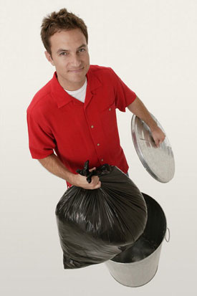

Slide 55
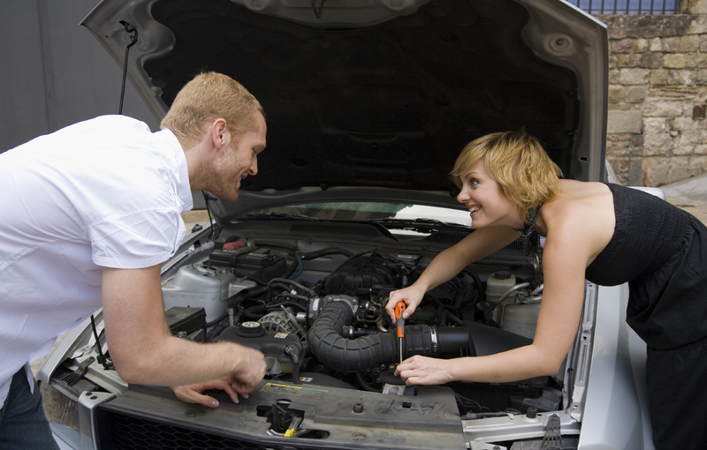

Slide 56

Now what’s going on?
Negative
or
Positive?
Punishment
or
Reinforcement?

Slide 57
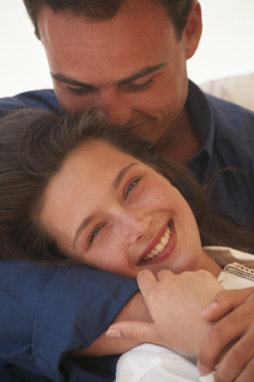

Slide 58
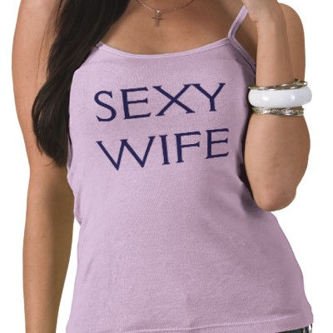

Slide 59
Operant Conditioning and the Brain
Dopamine
Helps you adjust and organize your behavior to achieve your goals

Slide 60
Effective Punishment
Should be swift, consistent, appropriately aversive
If it’s not, then it causes…
Increase in aggressive behaviors
Fear of the person who punishes
Most effective when combined with reinforcement for desired behavior

Slide 61
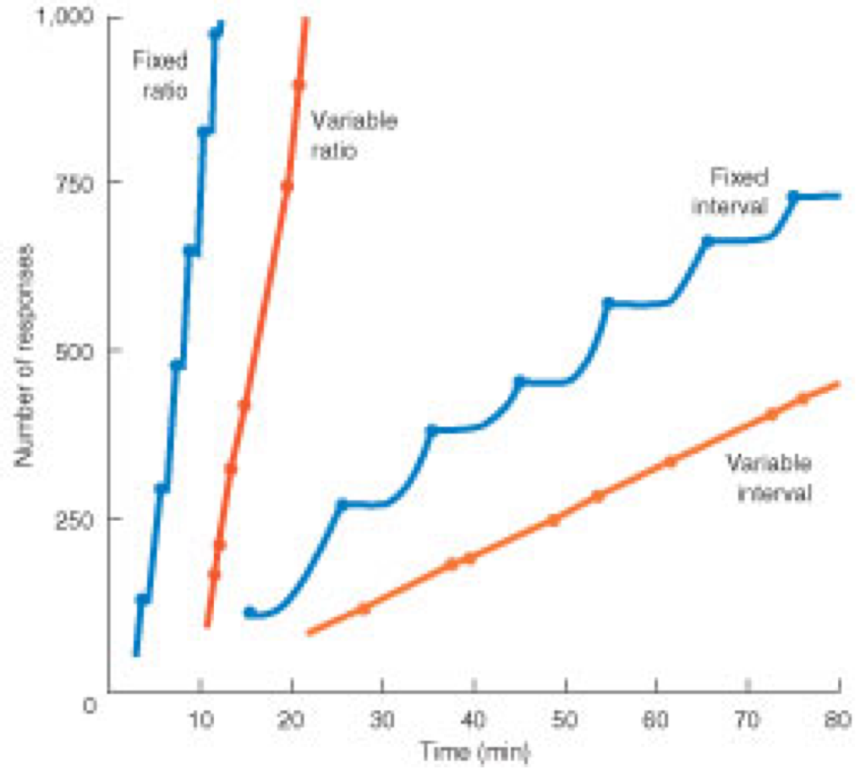
Reinforcement Schedules
Continuous
Partial
Fixed interval
Variable interval
Fixed ratio
Variable ratio

Slide 62
Types of Learning
Classical conditioning
Operant conditioning
Cognitive and social learning
Notes:
Kristen Anno
Amea Givens
Nathaniel Gonzales
Elisha Guillory
Diane Kamali-Meech
Michelle Mcclendon
Veronica Rodriguez
Brandon Tate
Brian Tate
Johnny Thomas
Rayleen R
Norma Alvarez

Slide 63
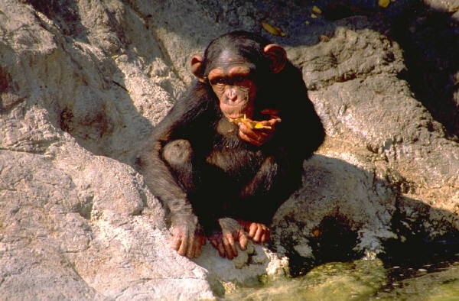
Cognitive Learning
Insight learning
“Aha” experience

Slide 64
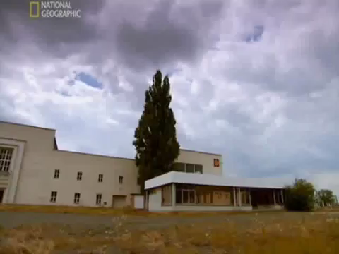

Slide 65
Observational Learning
Bandura’s social learning theory
Bobo doll study
Modeling
Learning from models

Slide 66


